Slide 1


Platform Solutions
Innovation Challenge Statuesque
Run your business on an agile platform with power of data science and data visualization
- HCM

Slide 2




Platform Solutions
Innovation Challenge Statuesque
Application
Analytics & AI
Mobile
Data Visualization
- HCM

Slide 3





Judicial
Medical
Logistic
Finance
Help-Desk
Manufacturing
Sales & Marketing
Service Management
Fleet Management
Human Capital Management
- HCM

Slide 4
Workflow Management
Dashboard
- HCM

Slide 5
6
1
Interview Status Update & Recruiting
Job role
Identification
Template
Recruitment Management
2
Recruitment Scheduling
5
Interview Scheduling
4
Shortlisting
3
Online Application Capturing
- HCM

Slide 6
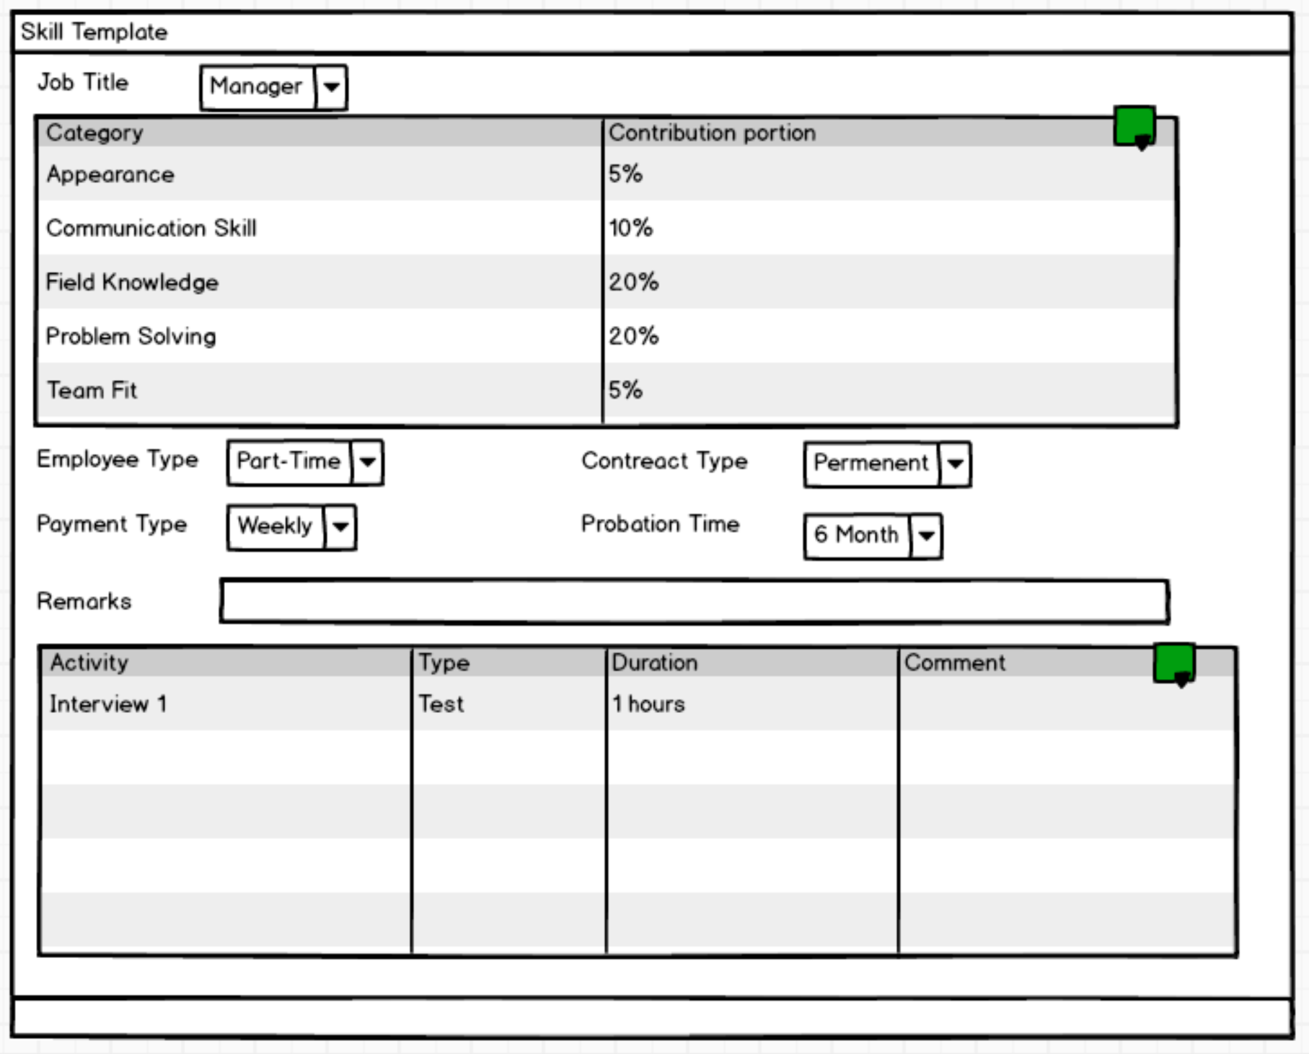
- HCM

Slide 7
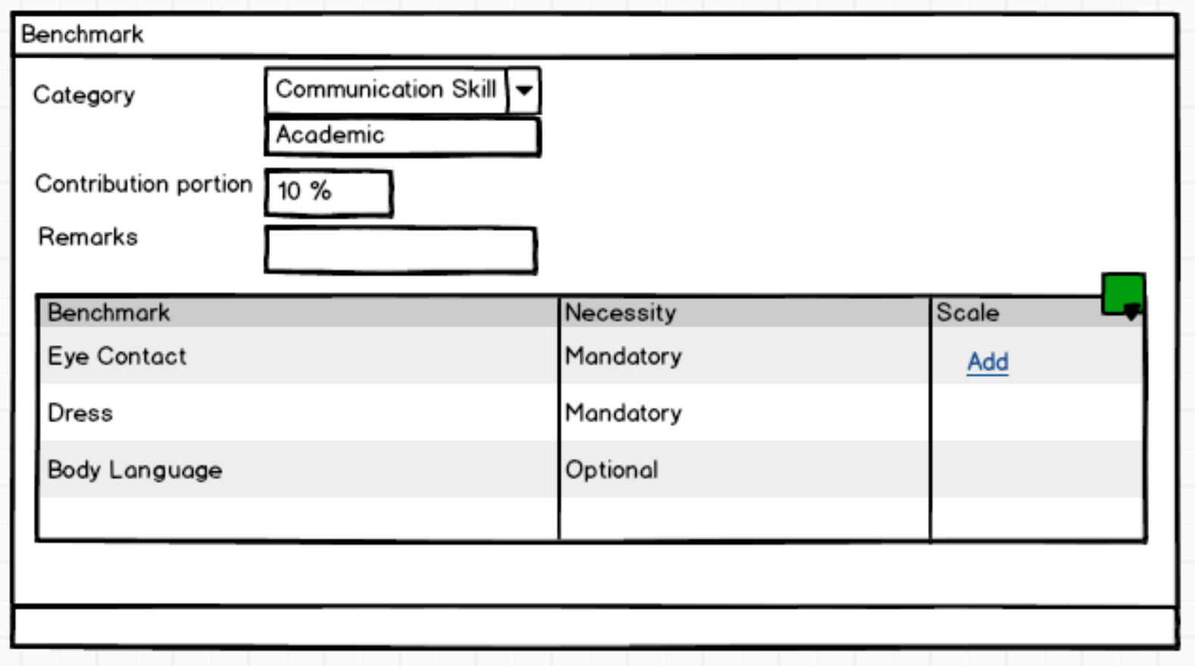
- HCM

Slide 8
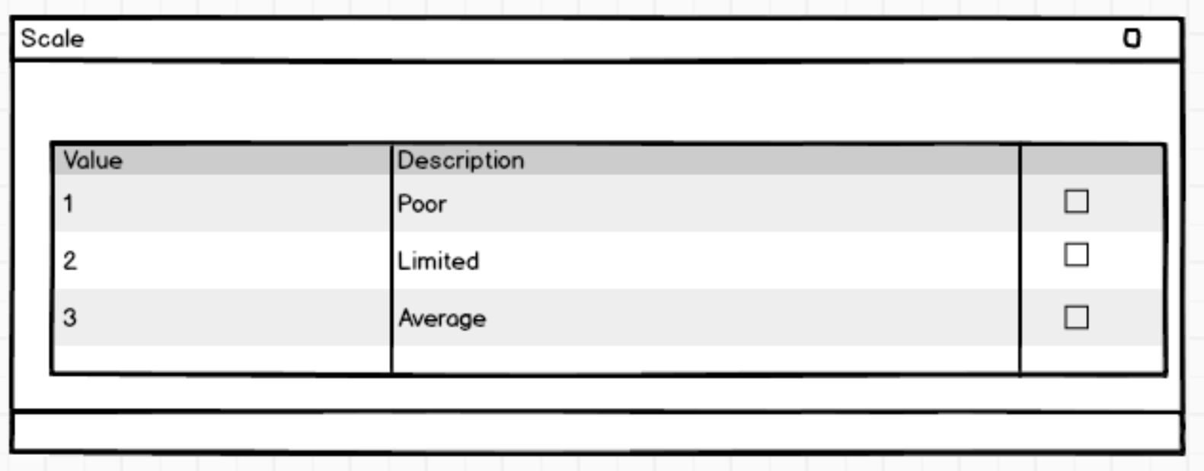
- HCM

Slide 9
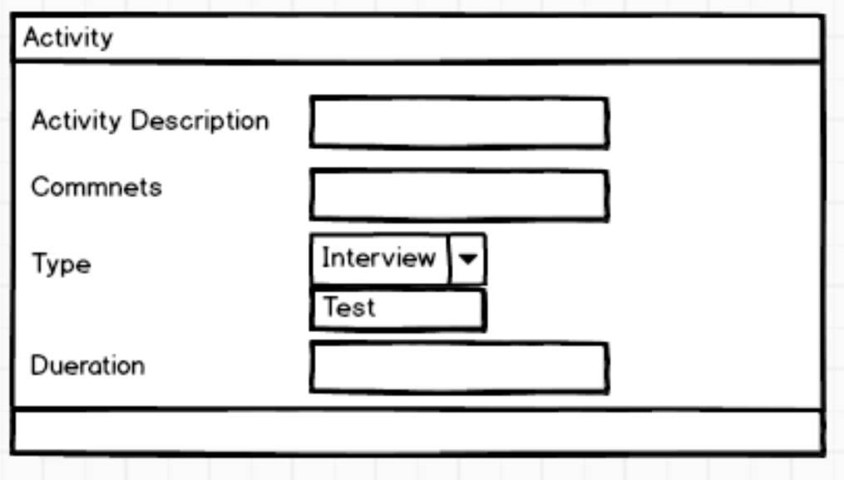
- HCM

Slide 10
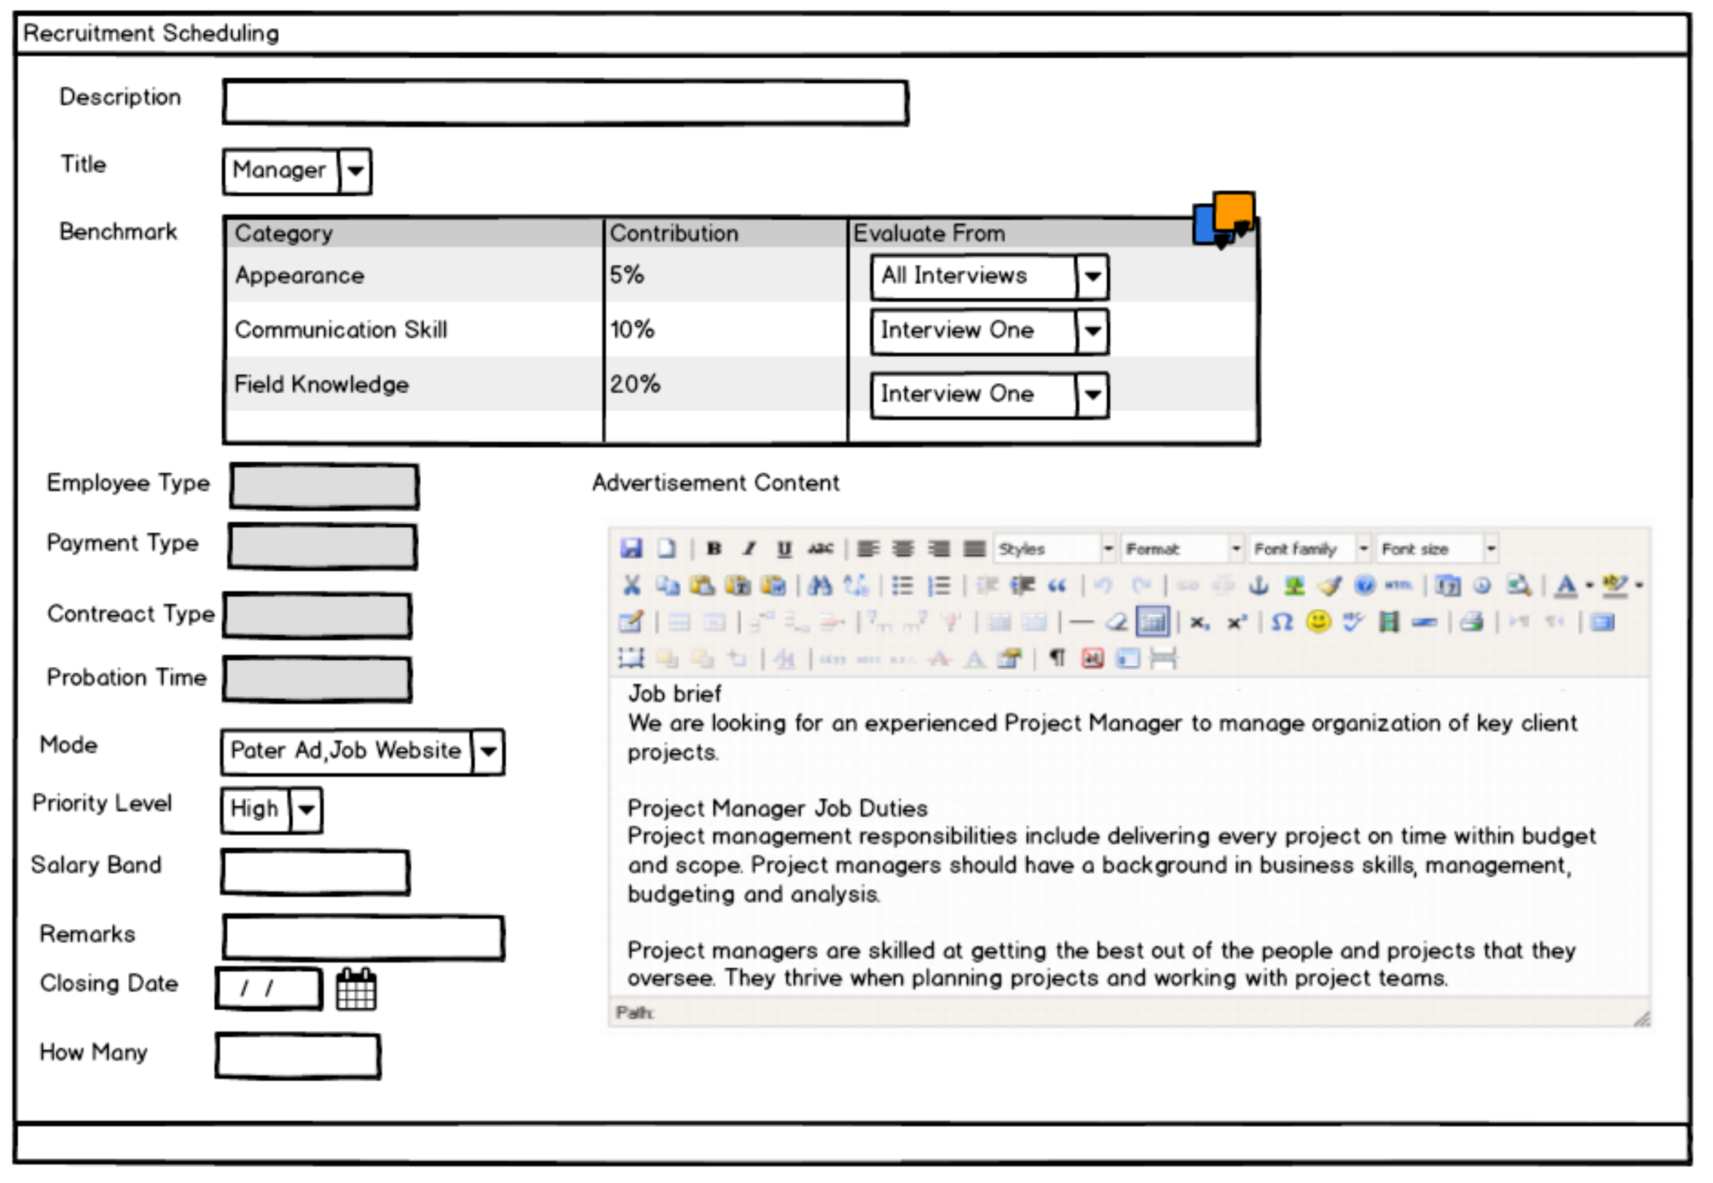
- HCM

Slide 11
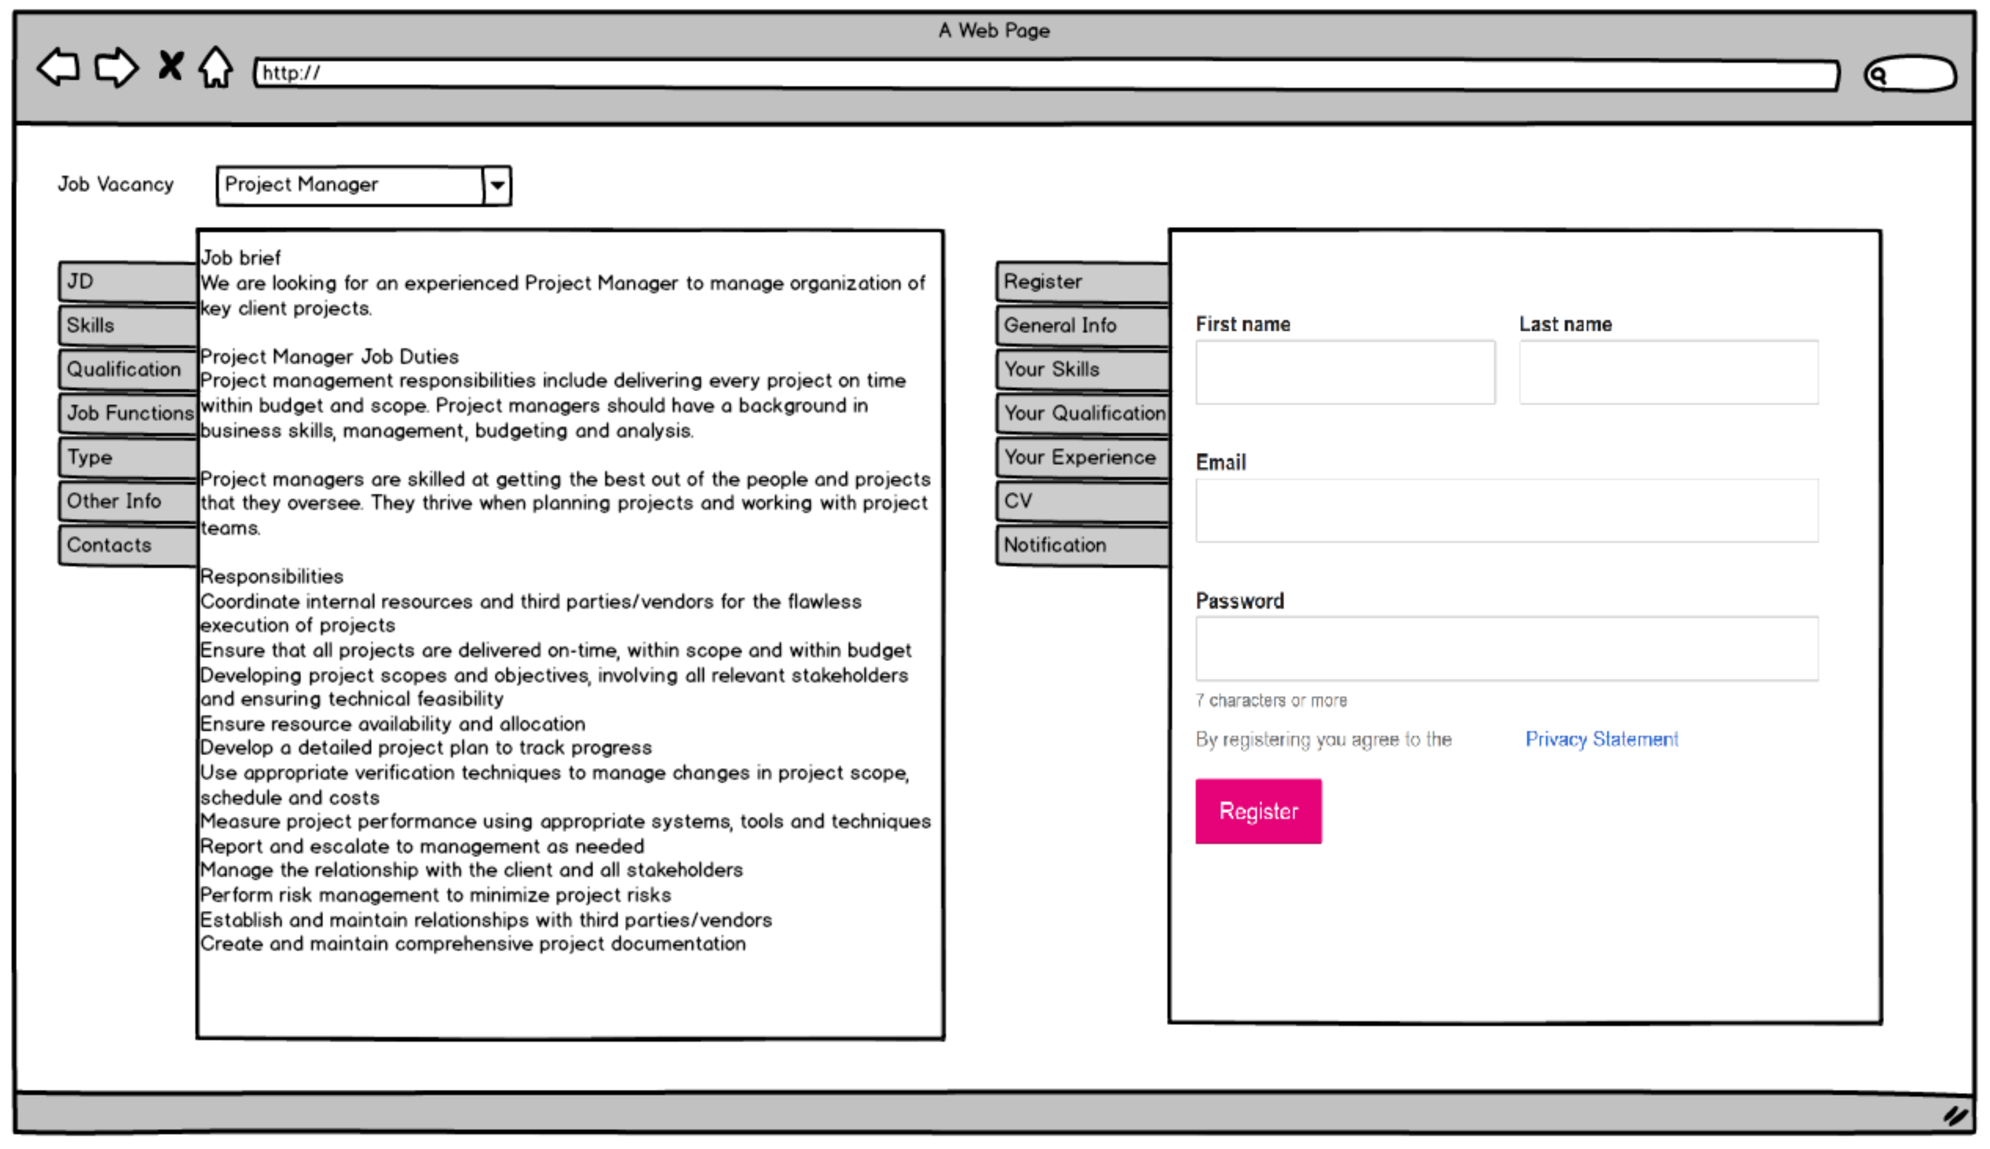

- HCM

Slide 12
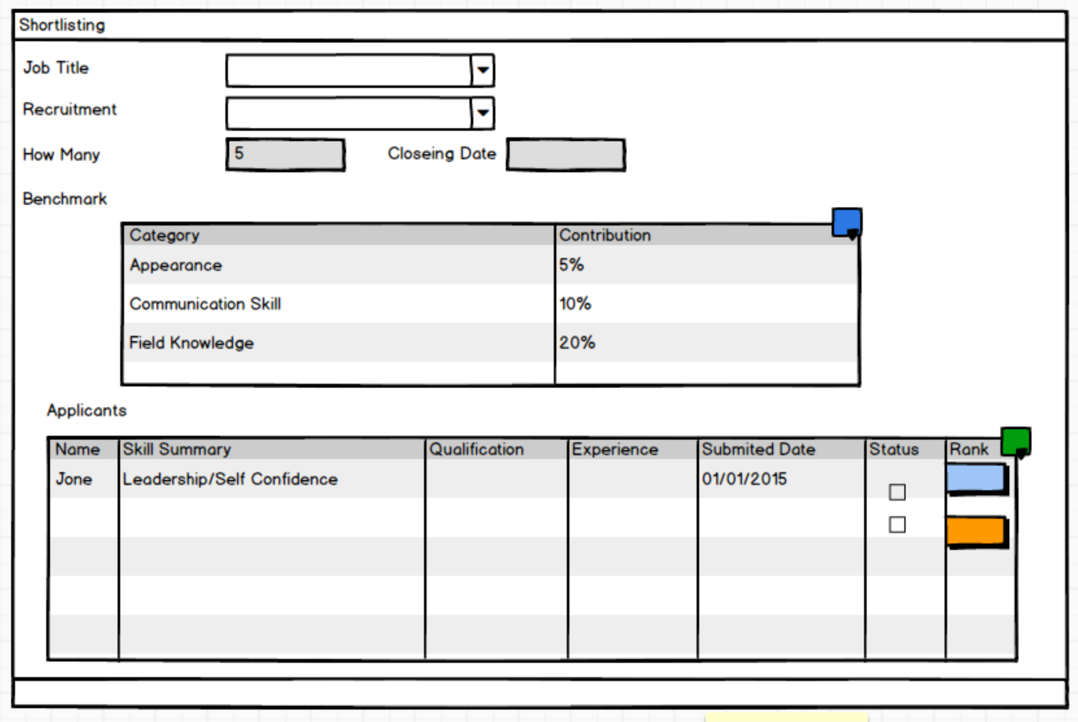
- HCM

Slide 13
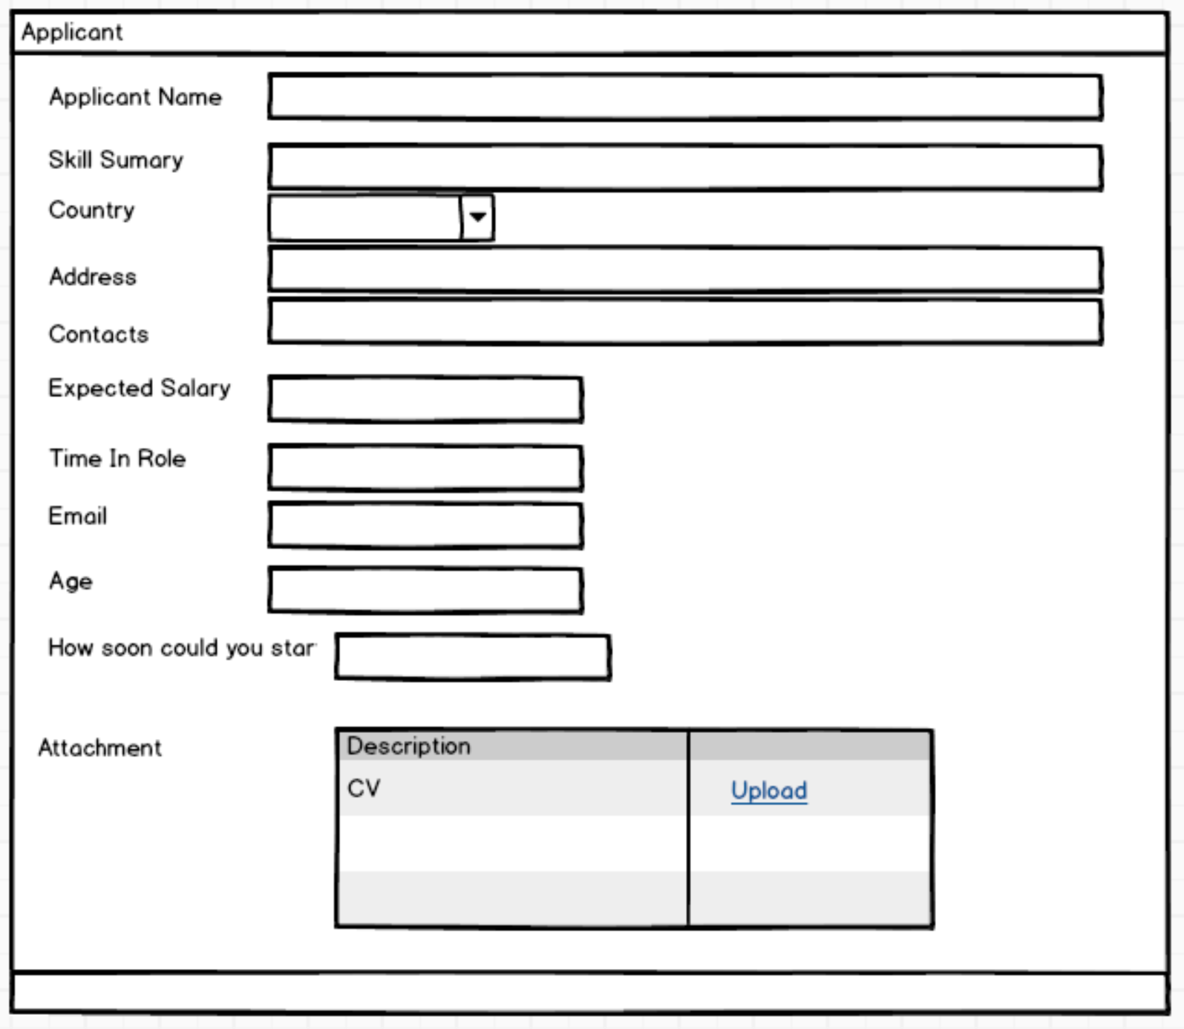
- HCM

Slide 14
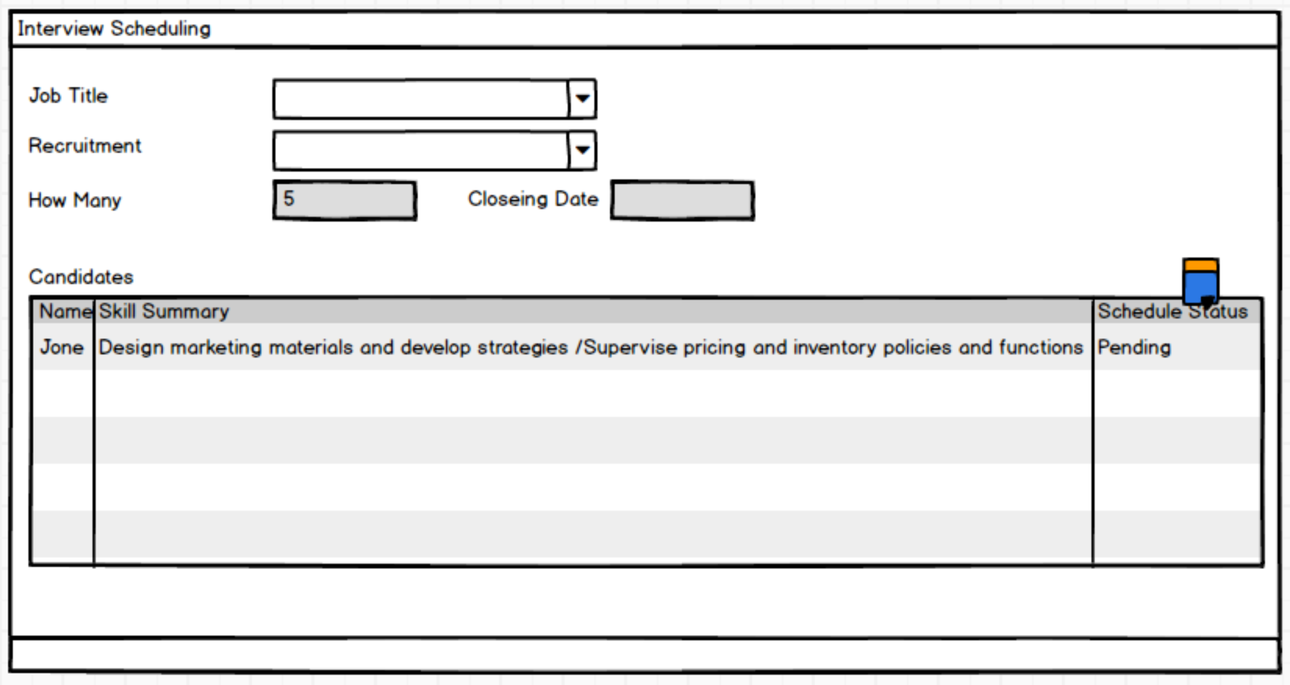
- HCM

Slide 15
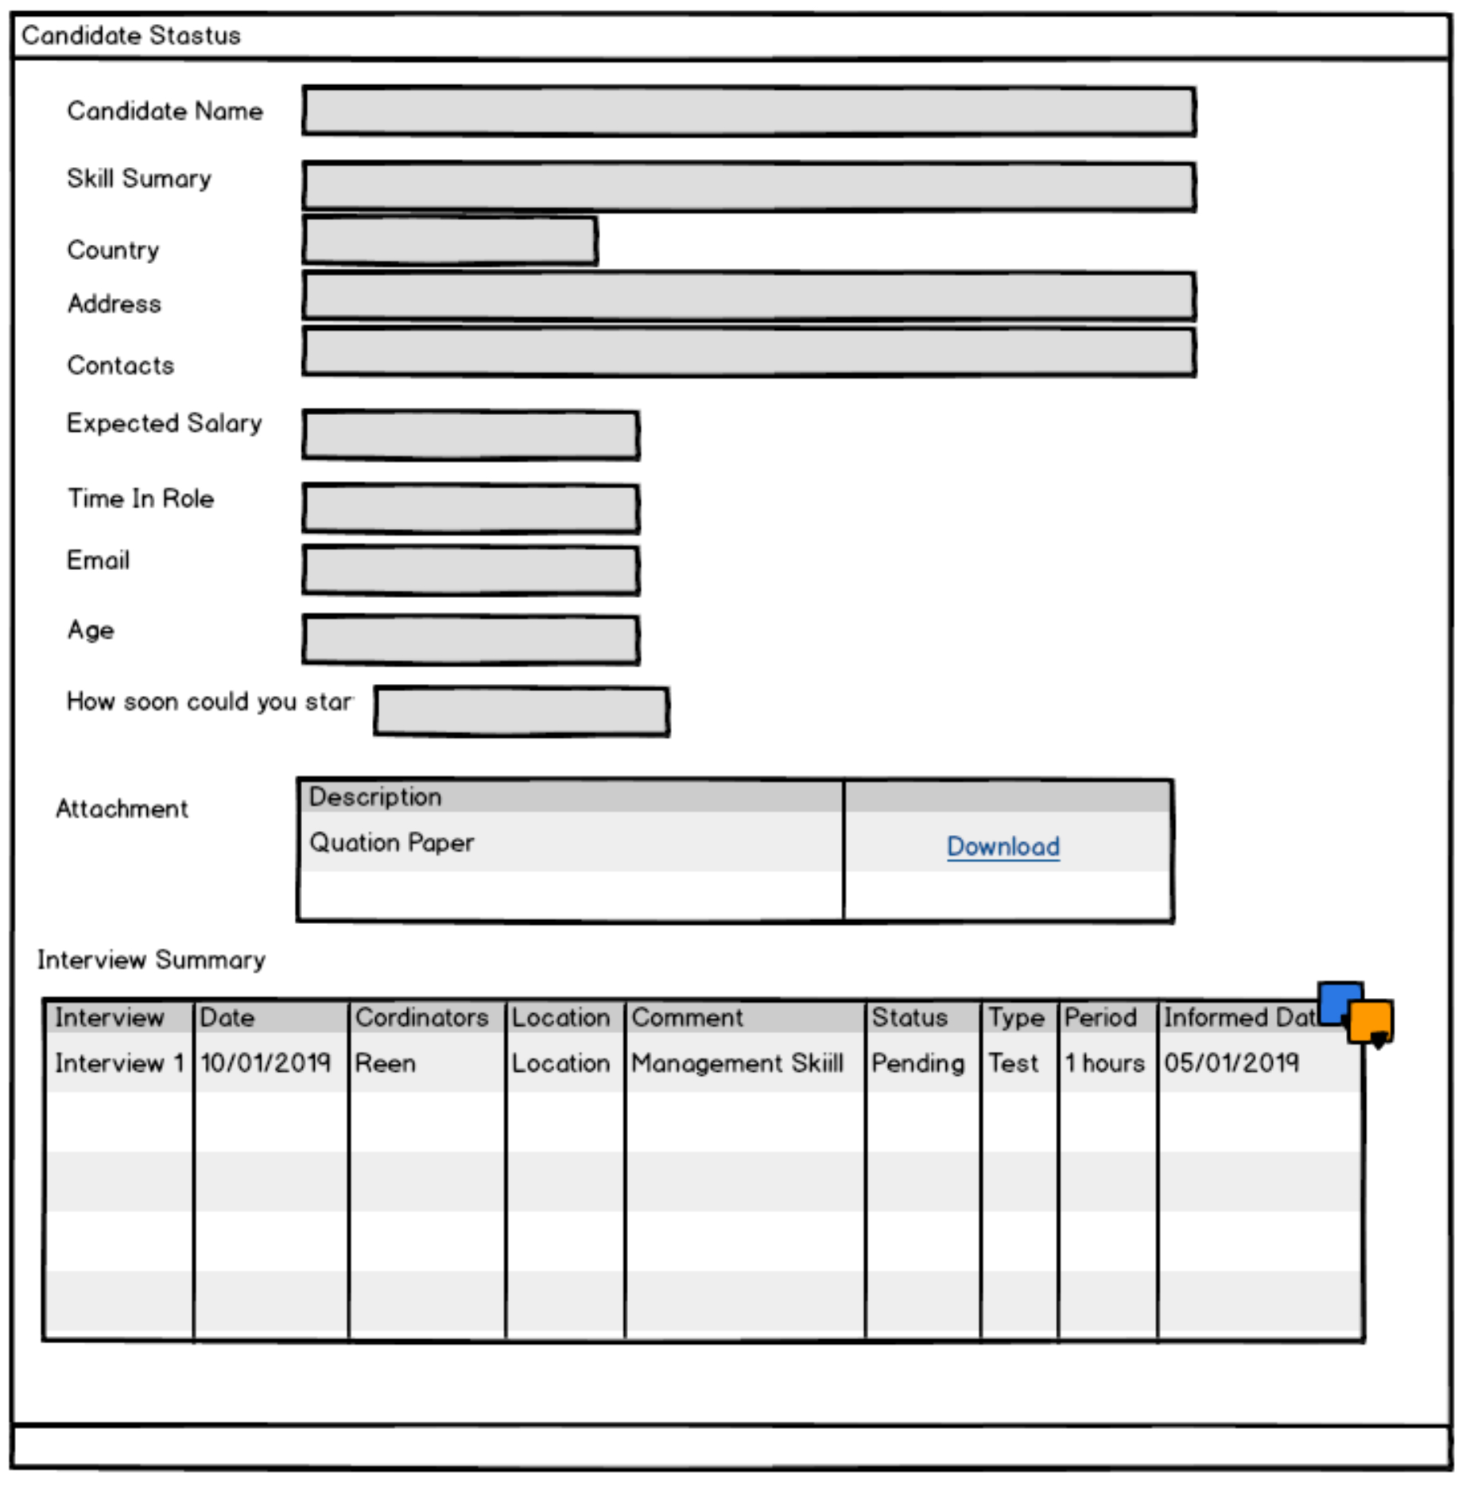
- HCM

Slide 16
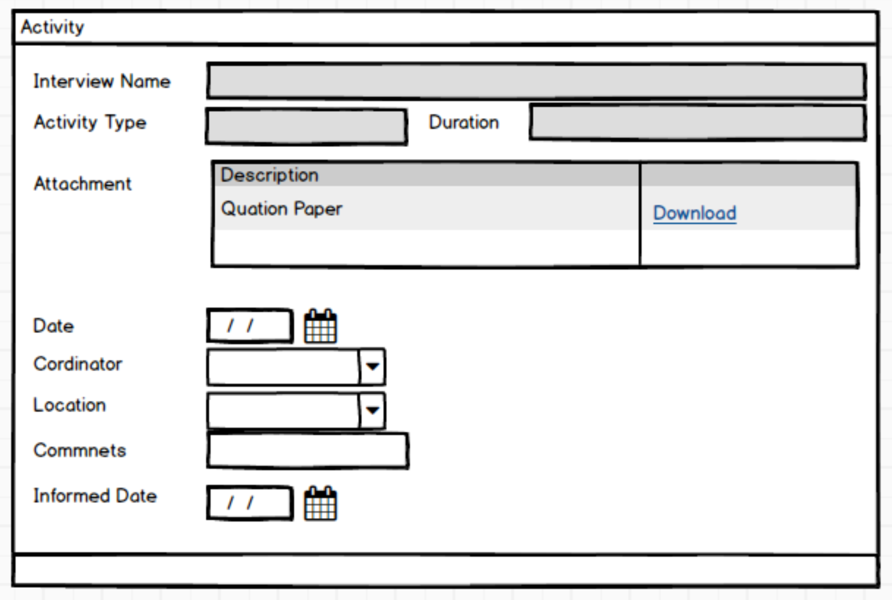
- HCM

Slide 17
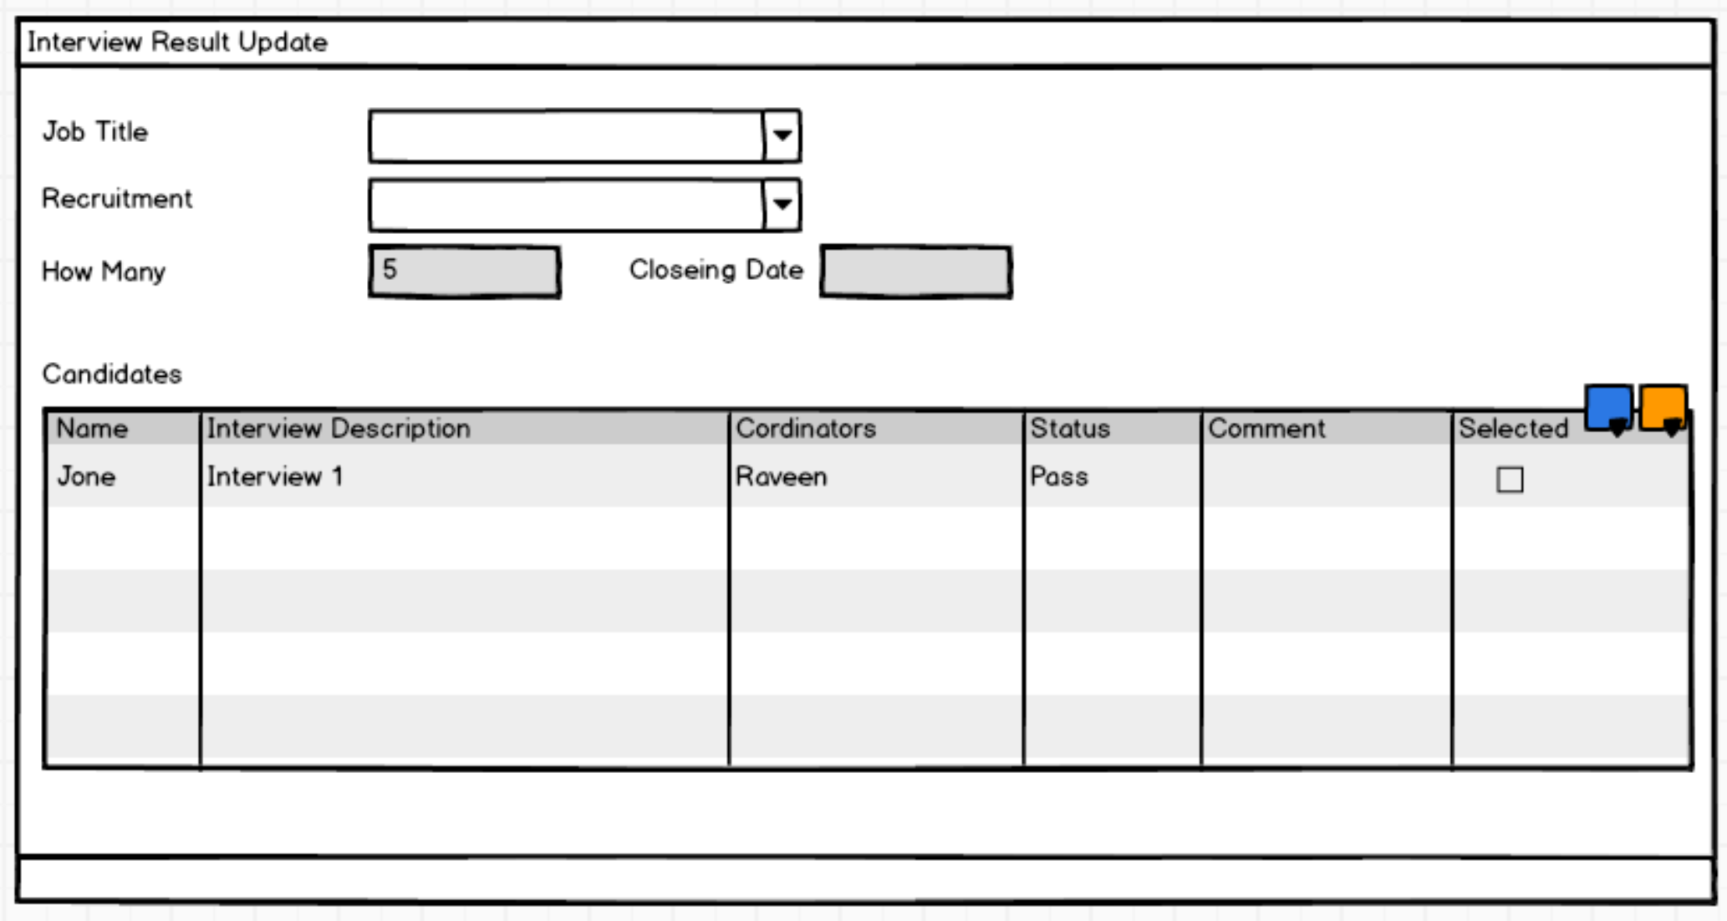
- HCM

Slide 18
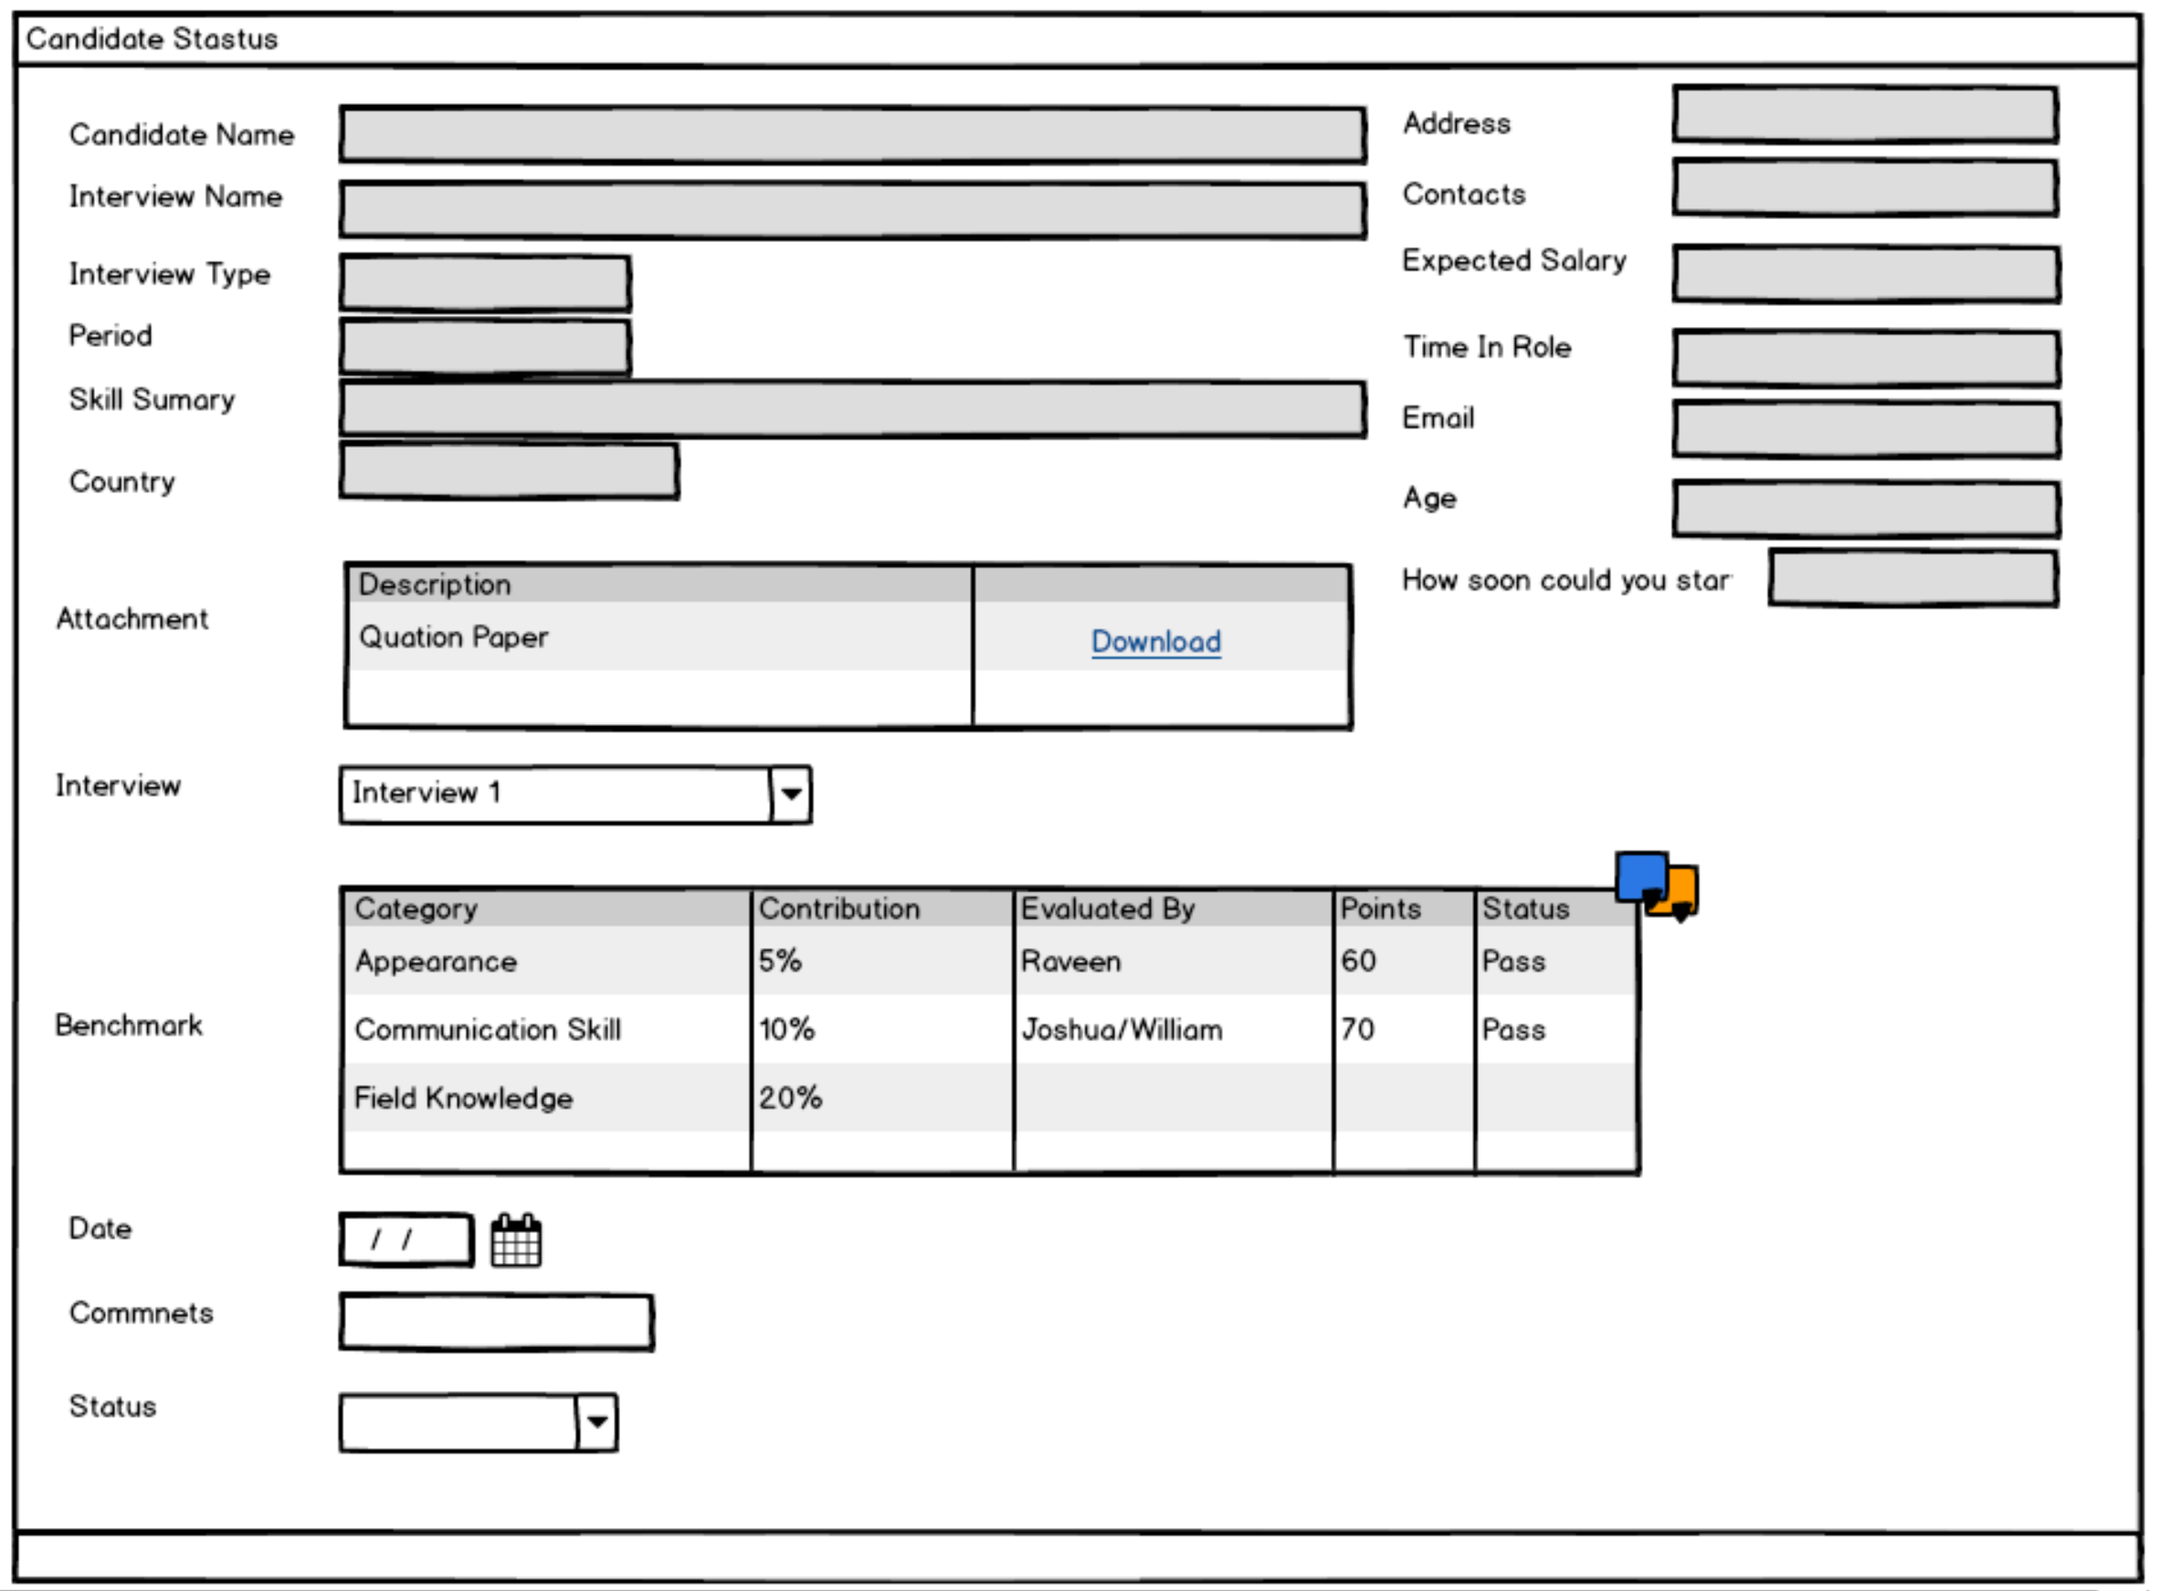
- HCM

Slide 19
1
Employee
Hierarchy
Leave
Management
3
Leave
Approval
2
Leave
Requisition
- HCM

Slide 20
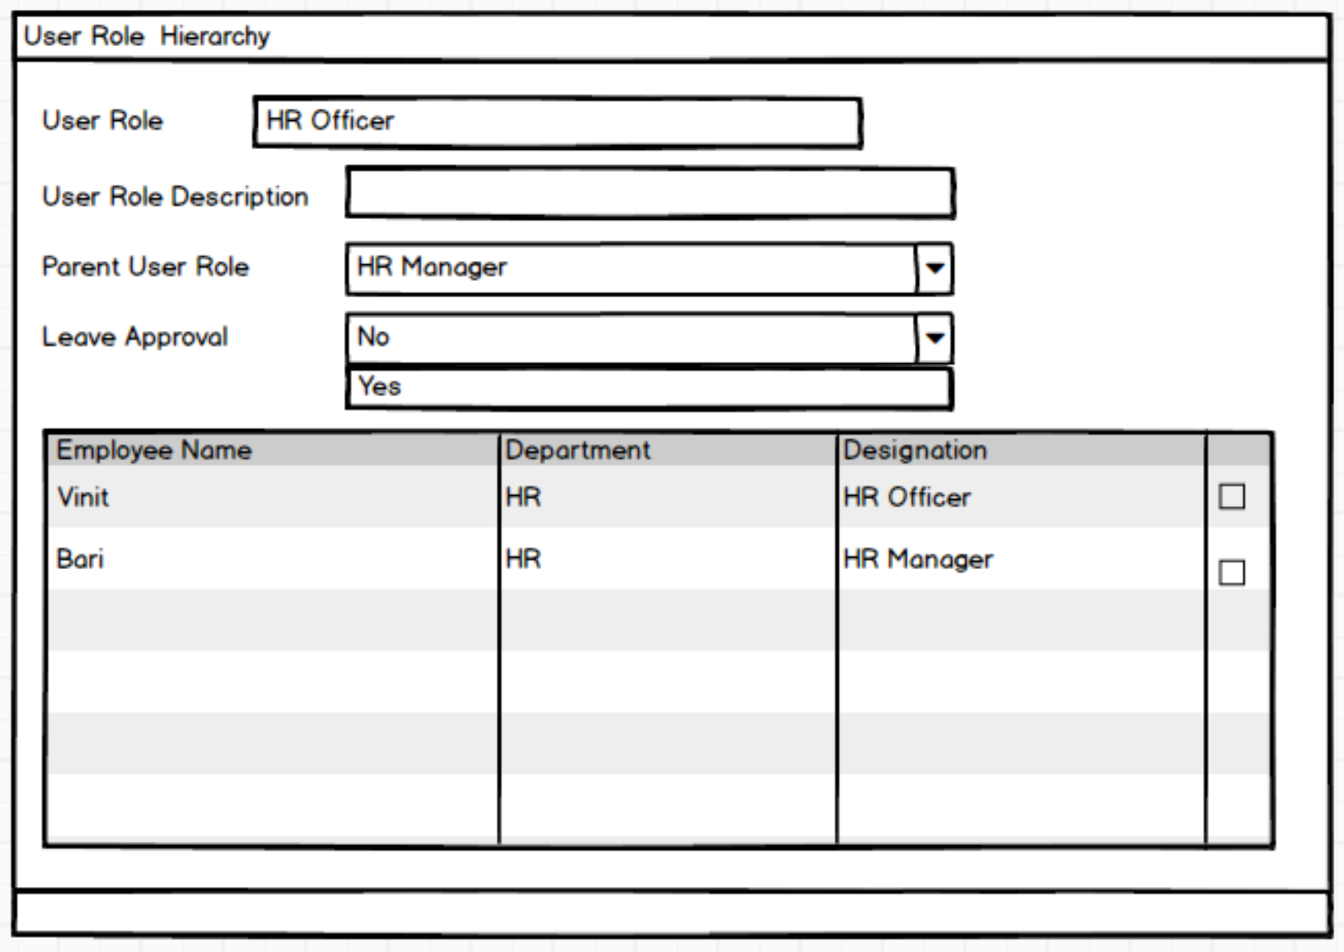
- HCM

Slide 21
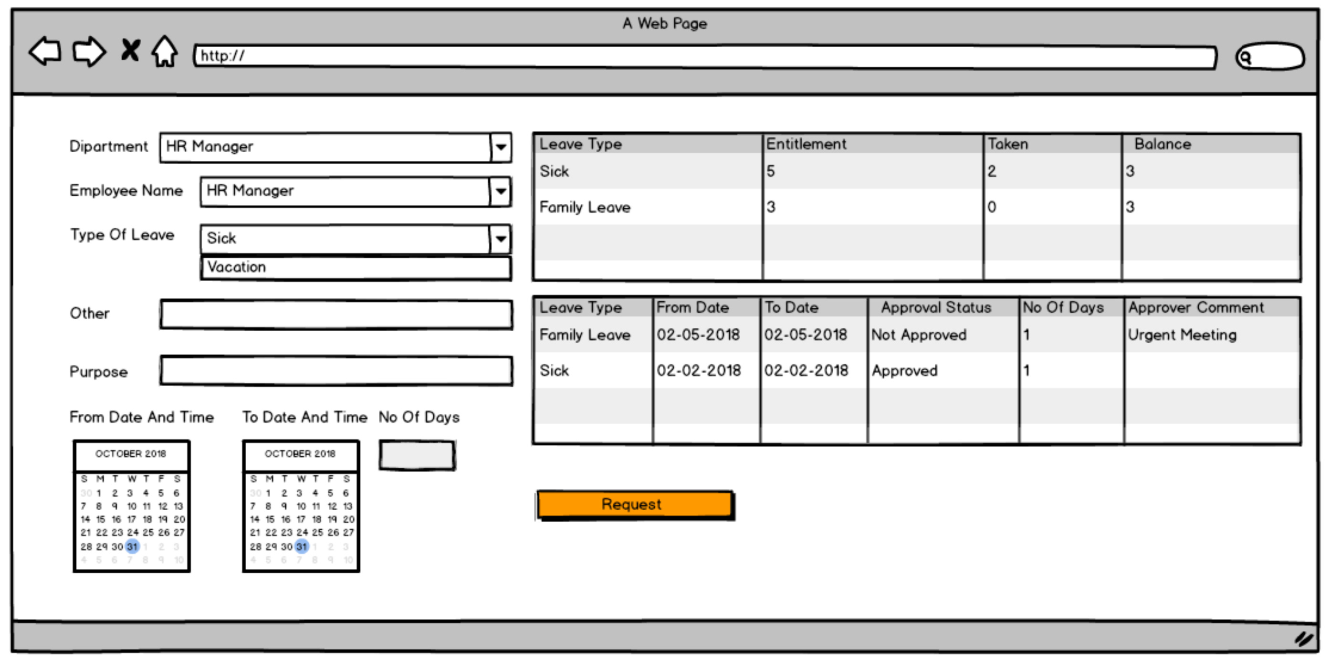
- HCM

Slide 22
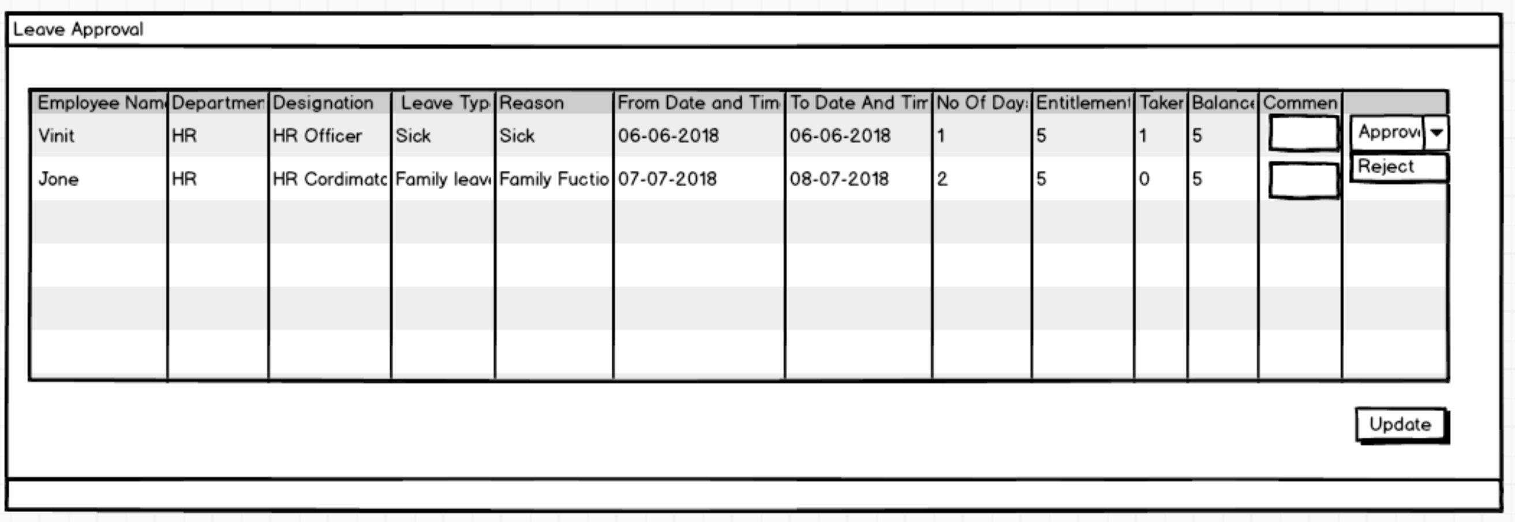
- HCM

Slide 23
7
1
Training Impact Analysis
Training
Requisition
Training
Management
6
Training Status Update
2
Training Need
Analysis
4
5
Shortlisting
Training Scheduling
3
Training
Resource Identification
- HCM

Slide 24
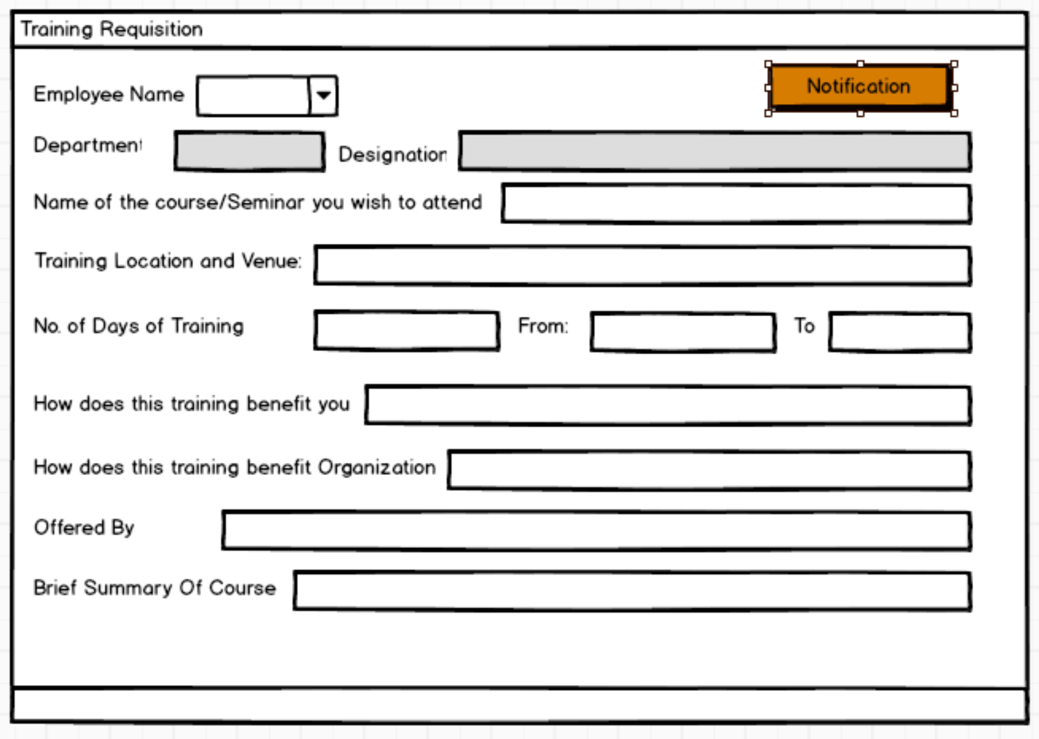
- HCM

Slide 25
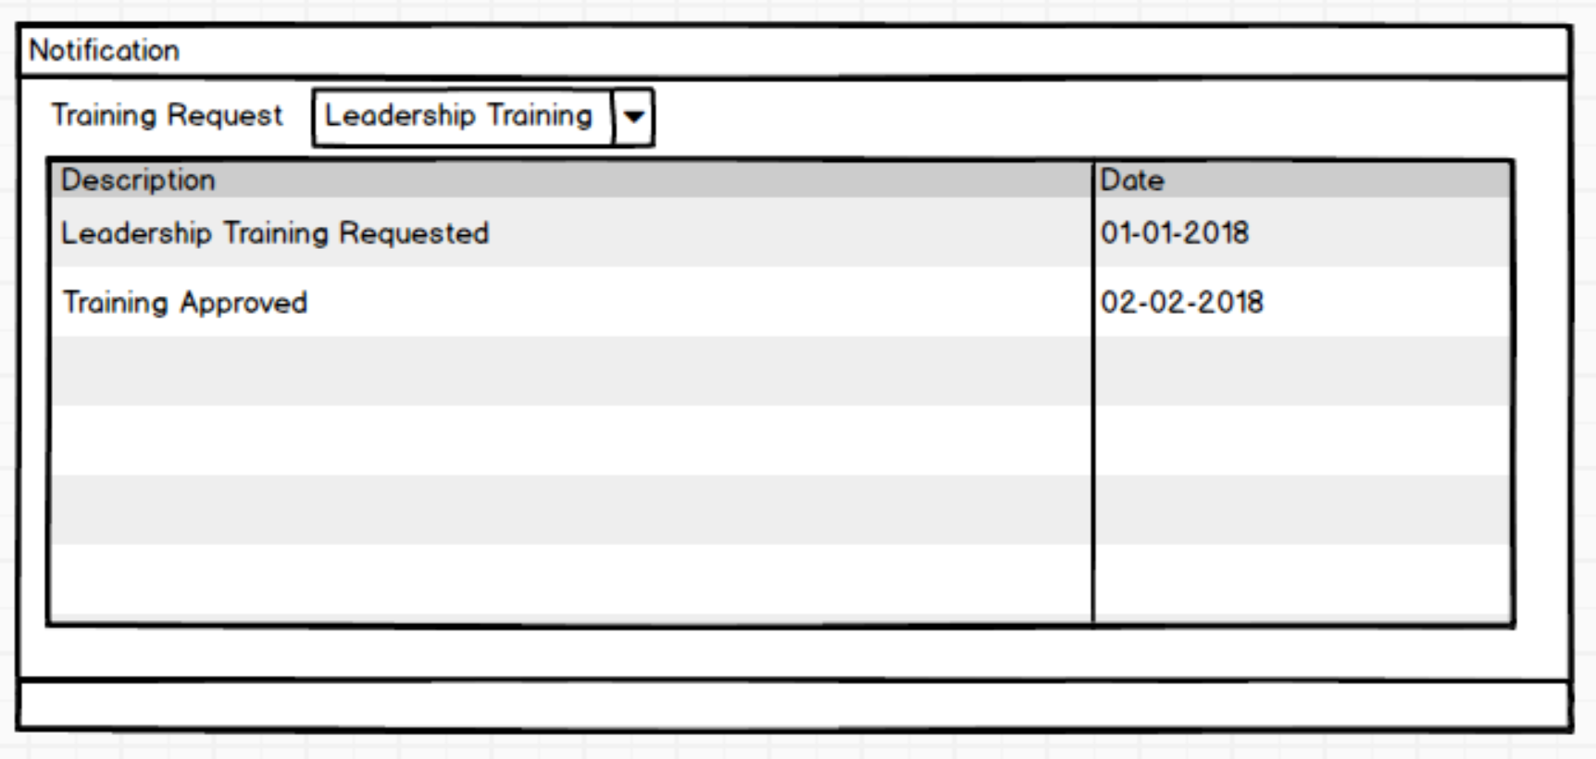
- HCM

Slide 26
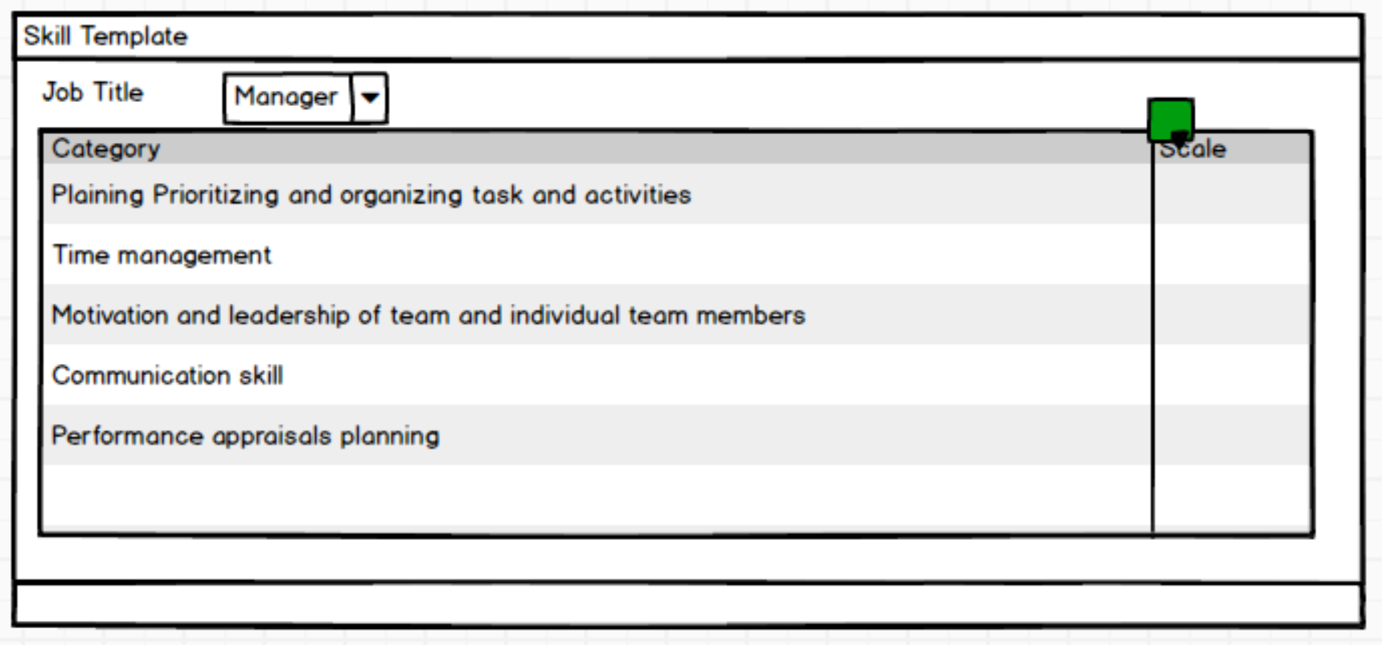
- HCM

Slide 27
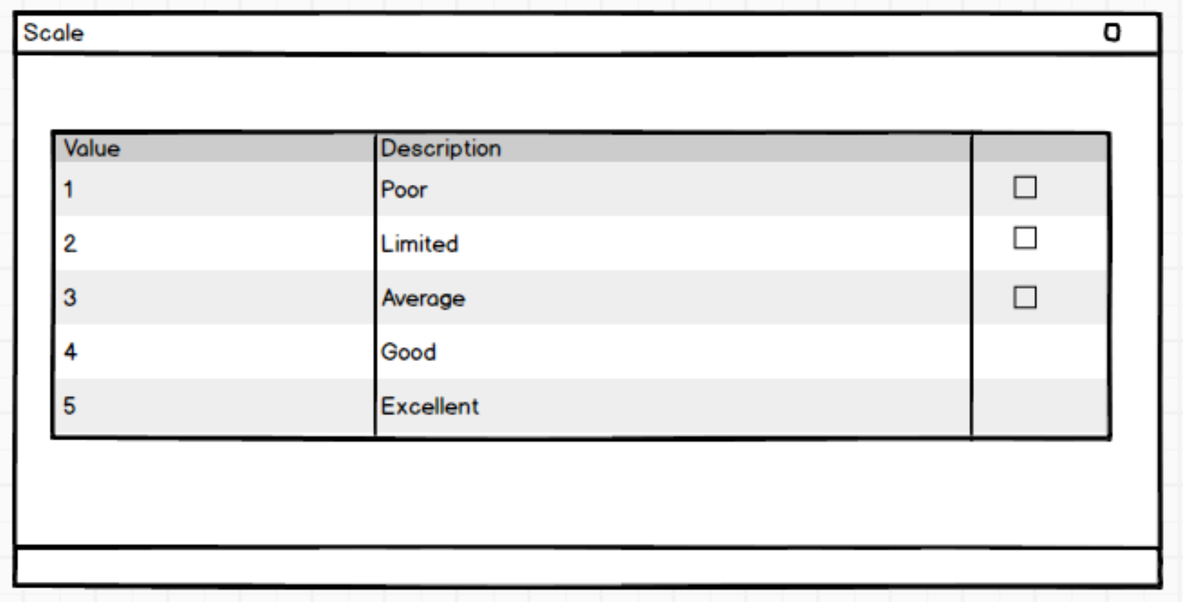
- HCM

Slide 28
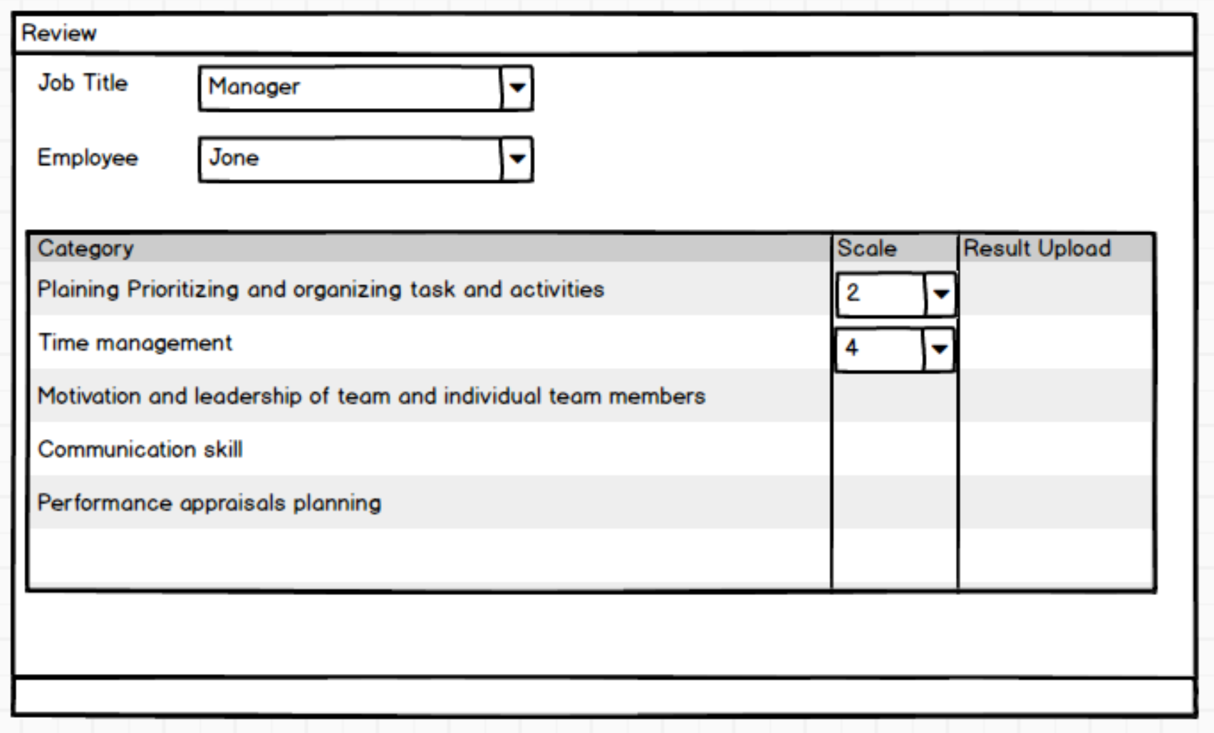
- HCM

Slide 29
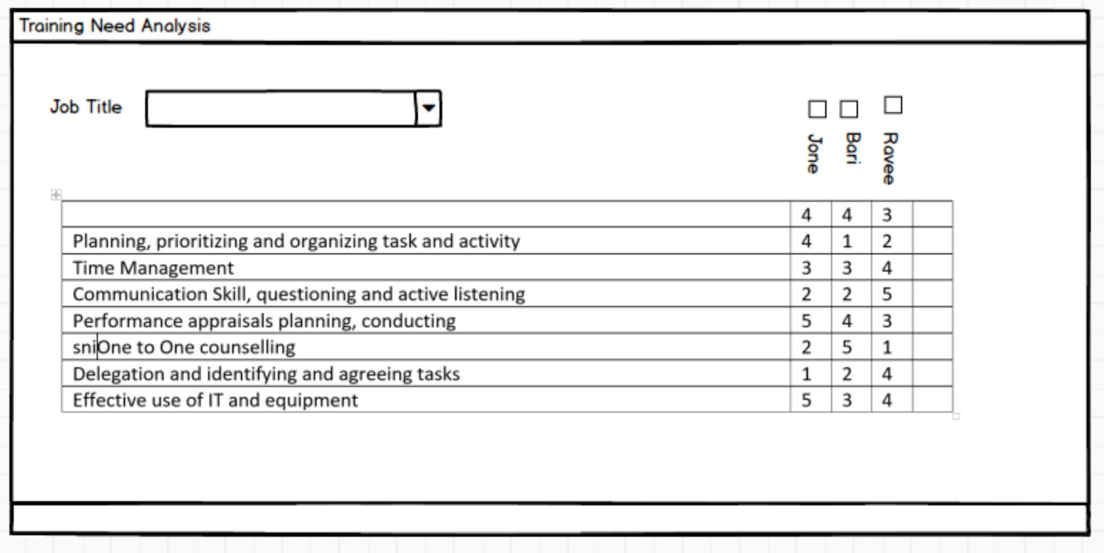
- HCM

Slide 30
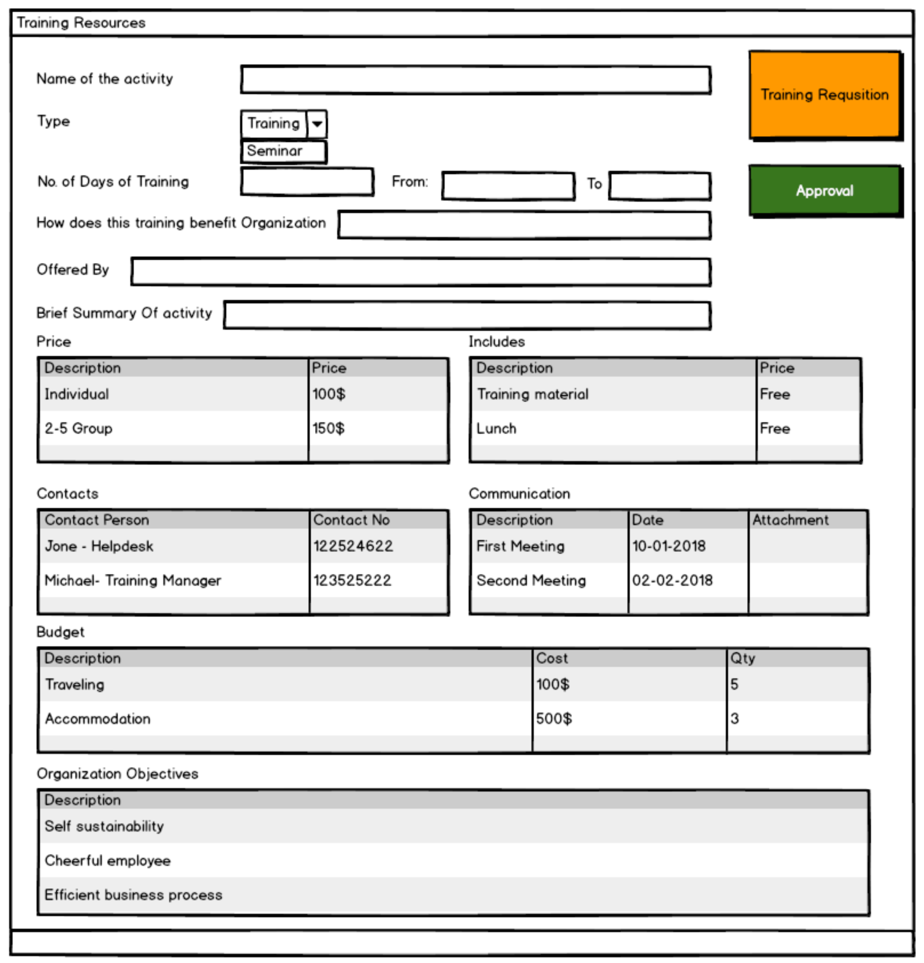
- HCM

Slide 31
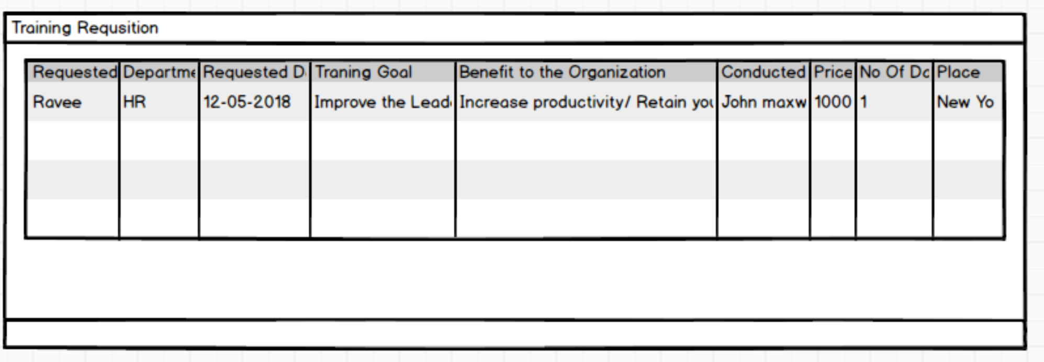
- HCM

Slide 32
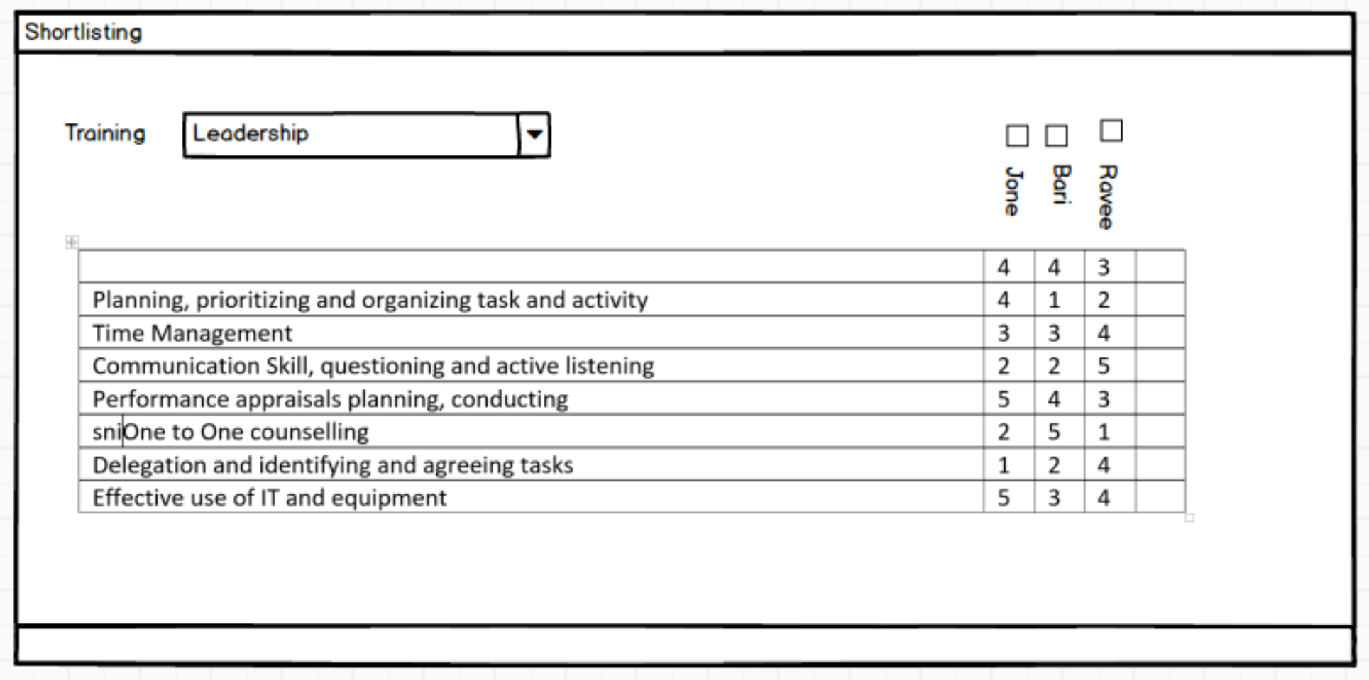
- HCM

Slide 33
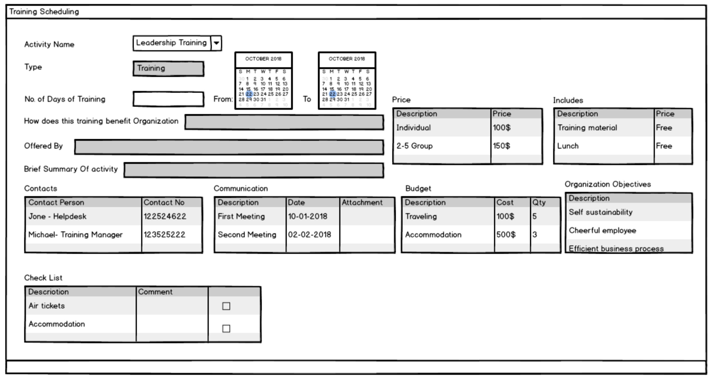
- HCM

Slide 34
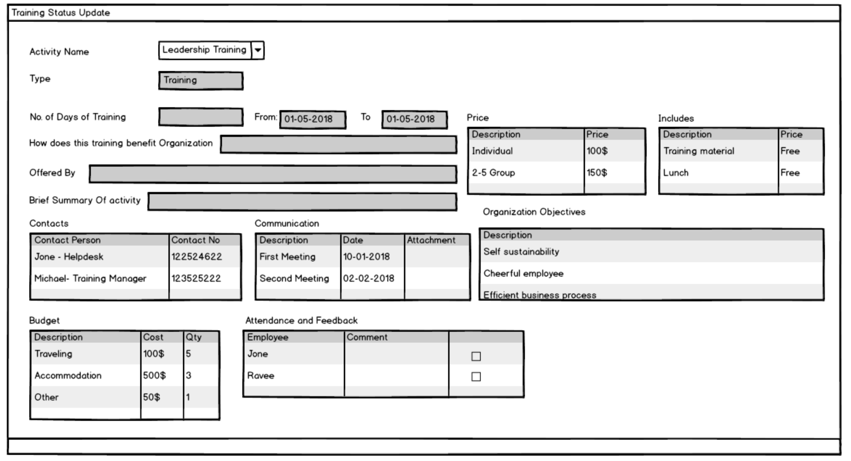
- HCM

Slide 35
1
Workflow
Setup
Document
Workflow
4
Workflow Notification
3
Workflow
Status Update
- HCM

Slide 36
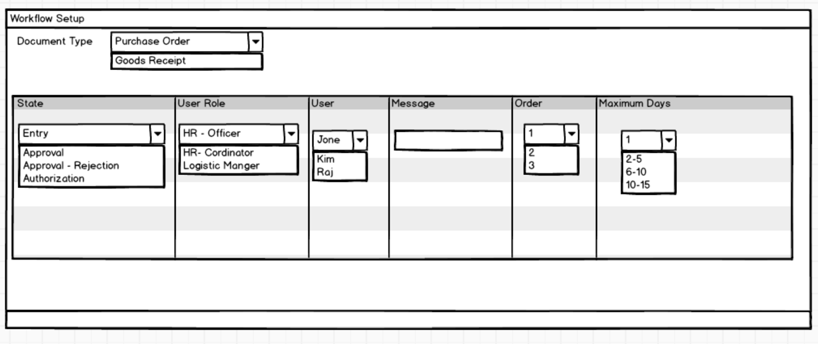
- HCM

Slide 37
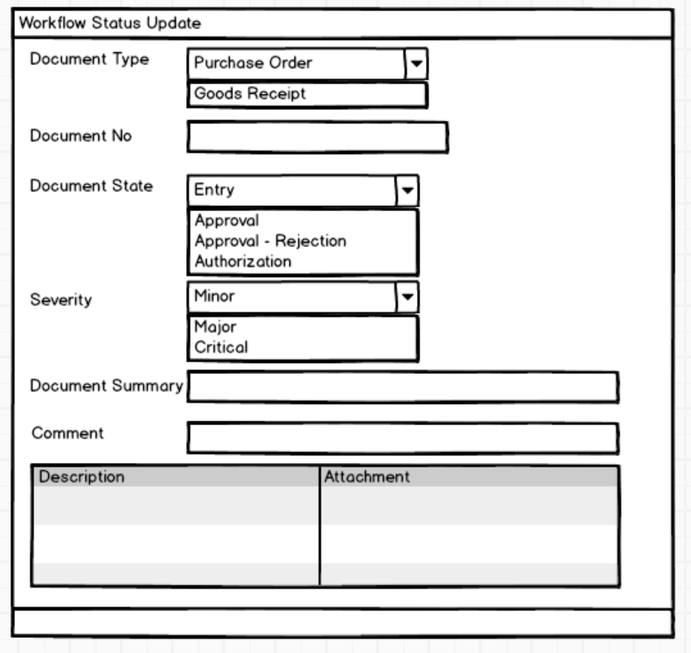
- HCM

Slide 38
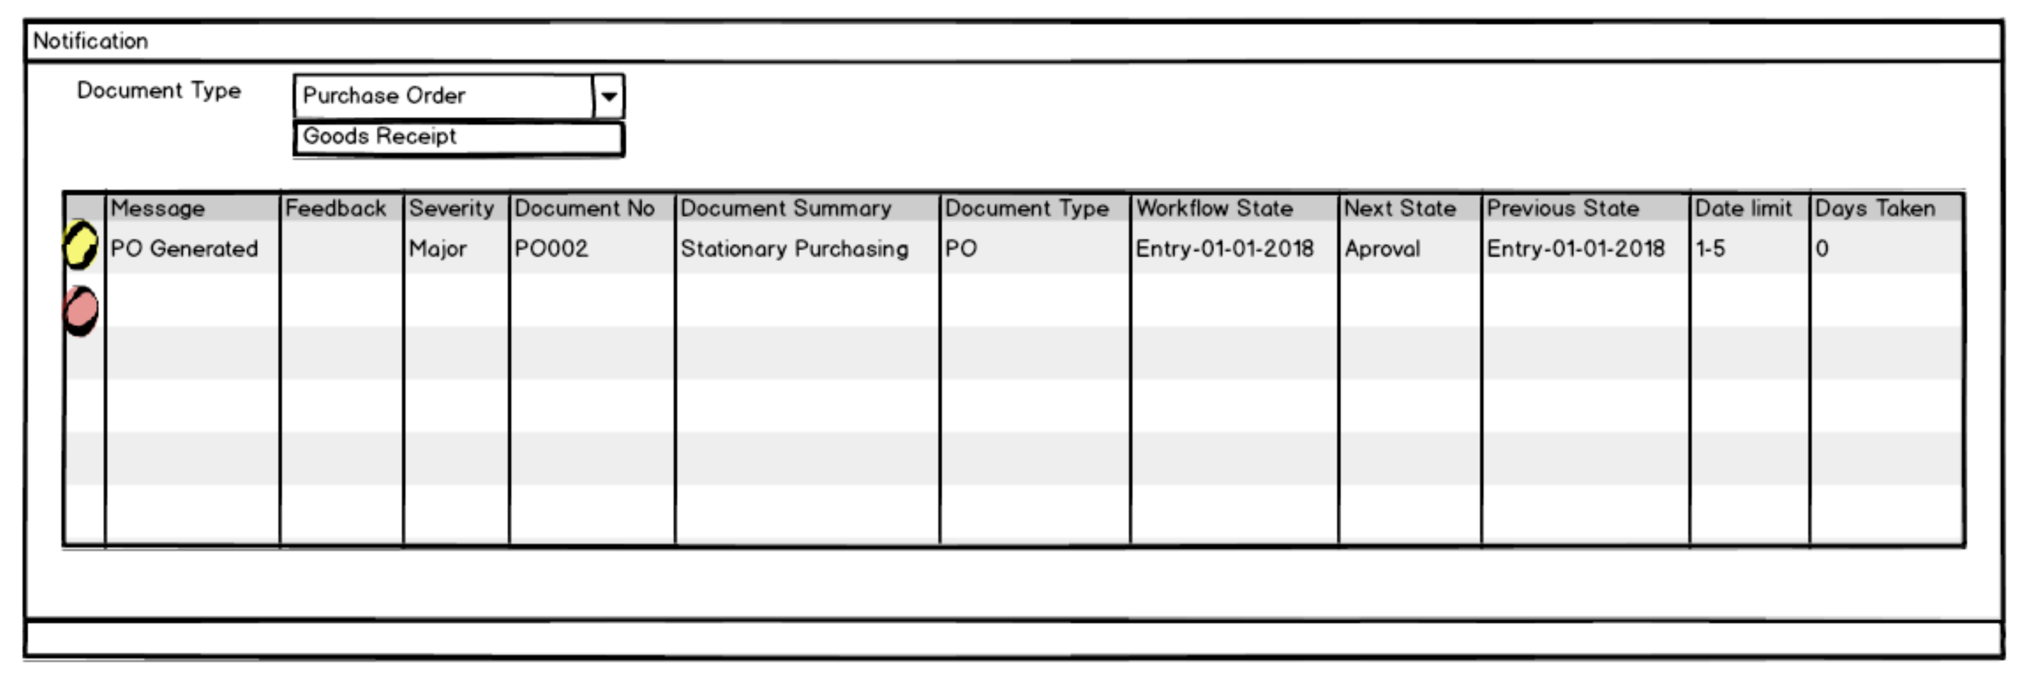
- HCM

Slide 39
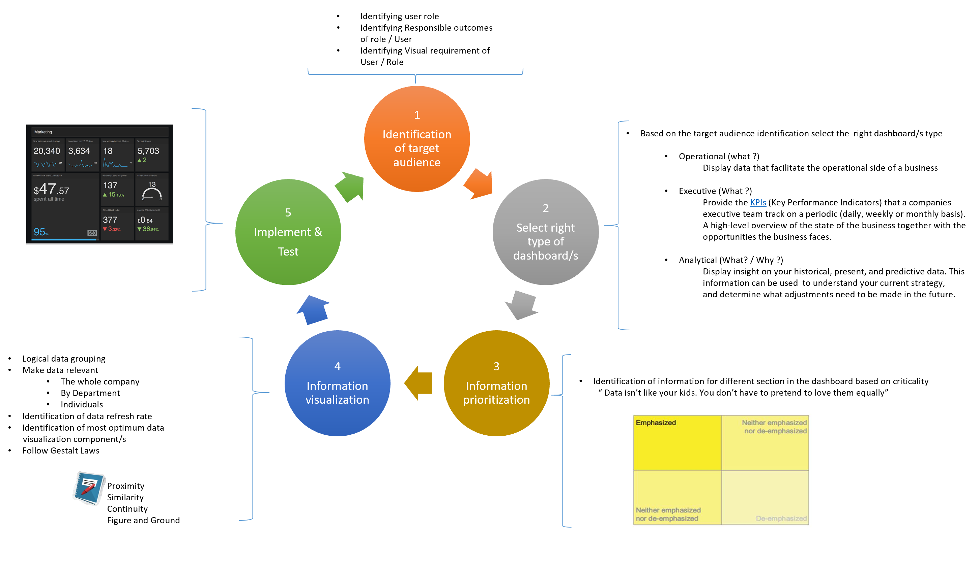
- HCM

